Slide 1

SNU
ROADMAP
Kush Goyal
P Vishnu Tej
Lakshay Jain
Moksh Jaswal
Mrityunjay Singh

Slide 2

Project Definition
An integrated web-based application for SNU students.
Application constitutes of :
E-Mart
Library
News Gallery
Resource Bank

Slide 3

Motivation
The motive behind SNU Roadmap is to help students and guide them throughout their journey at SNU.
Throughout our years at SNU which we spent on campus, each one of us has faced some or the other problems regarding different issues. Through this project, we try to tackle some of those challenges which students face on a daily basis.

Slide 4


E-Mart (Mini-Mart)
This module would display the products in Mini-Mart along with their availability and prices.
Students would be able to add products to their carts and pay for them and can pick up their order at any convenient time.
Additionally, we would render 3d models of items for aesthetic purposes.

Slide 5
FEATURES

Slide 6

SNULIB (Library)
A platform that will aid in the management of books currently available in the library. It will contain records of all the books from the library.
Its has two views, notably admin view and student view, with a secure authentication system.
The student can search for the books by name, see the status of the availability of the book and its location in the library.
The admin side can issue the book to the student and perform crud operations to delete and add new books and change the status and location of the books.
HTML,CSS,EJS,MONGODB,NODE JS,EXPRESS

Slide 7
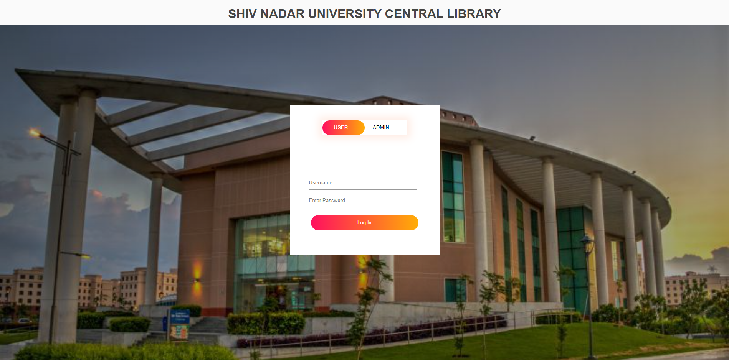

Slide 8
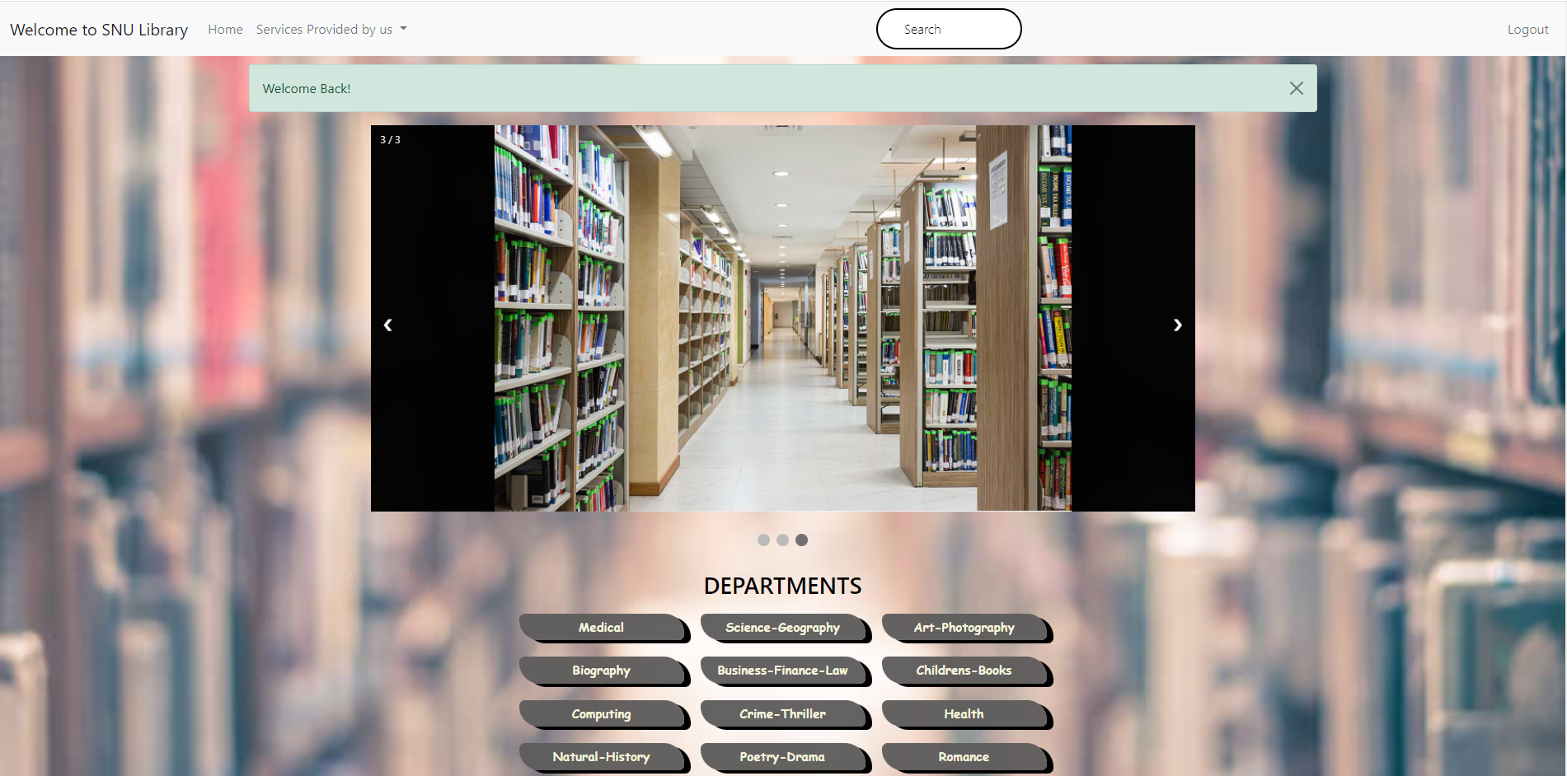

Slide 9



Slide 10


Slide 11

News Gallery
Catch up on the latest news surrounding our university in this module of our website.
Milestones, Achievements, Placements, Fests, Events, Webinars, etc., if it’s related to our university, it’s in our gallery.
The news would be curated regularly to keep the students up to date.
HTML,CSS,EJS,MONGODB,NODE JS,EXPRESS

Slide 12
FEATURES

Slide 13

Resource Bank
Students can see the reviews provided by their peers or their seniors who have already completed the course and devise their strategy.
The students can contribute resources, past quizzes and, other related materials.
This system helps to clear doubts and confusion regarding how to begin preparing for a particular course and, students can learn from others experiences.
HTML,CSS,EJS,MONGODB,NODE JS,EXPRESS

Slide 14
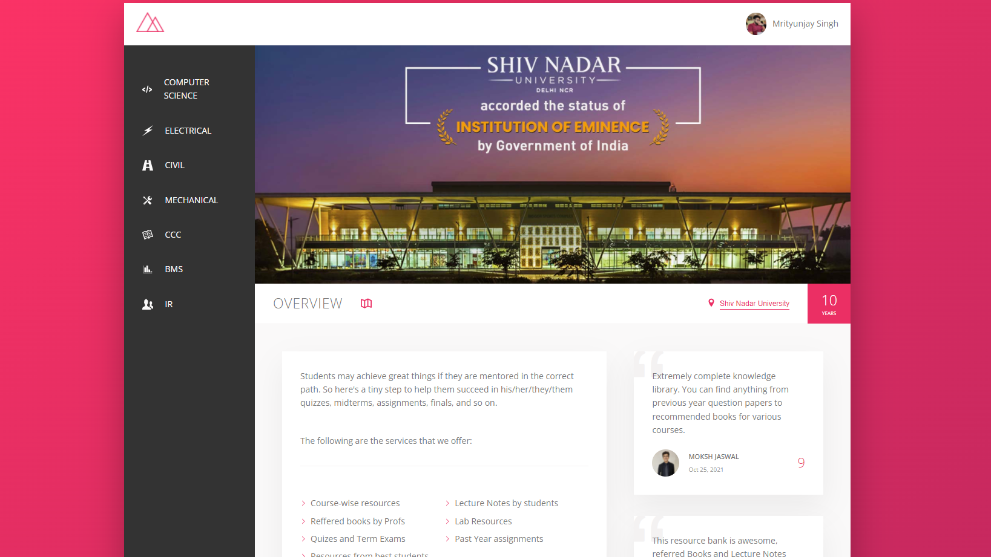
Home page

Slide 15
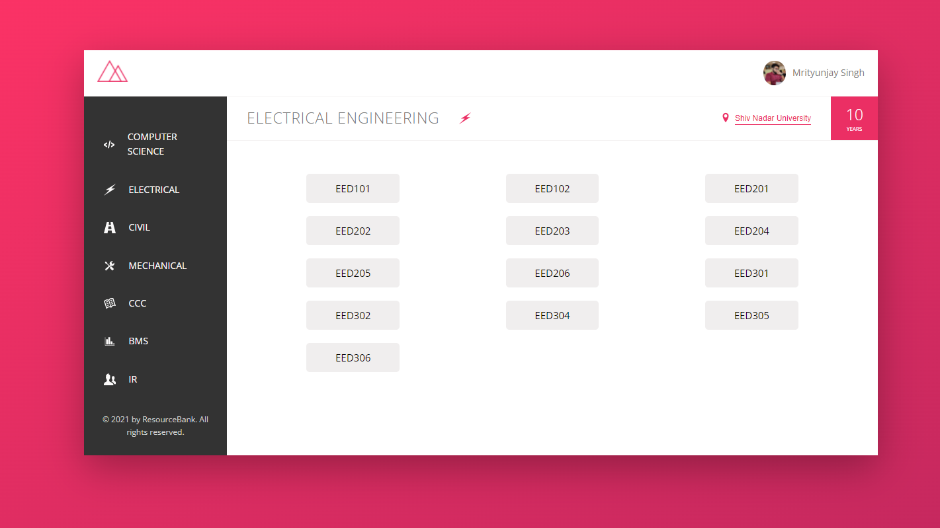
Courses

Slide 16
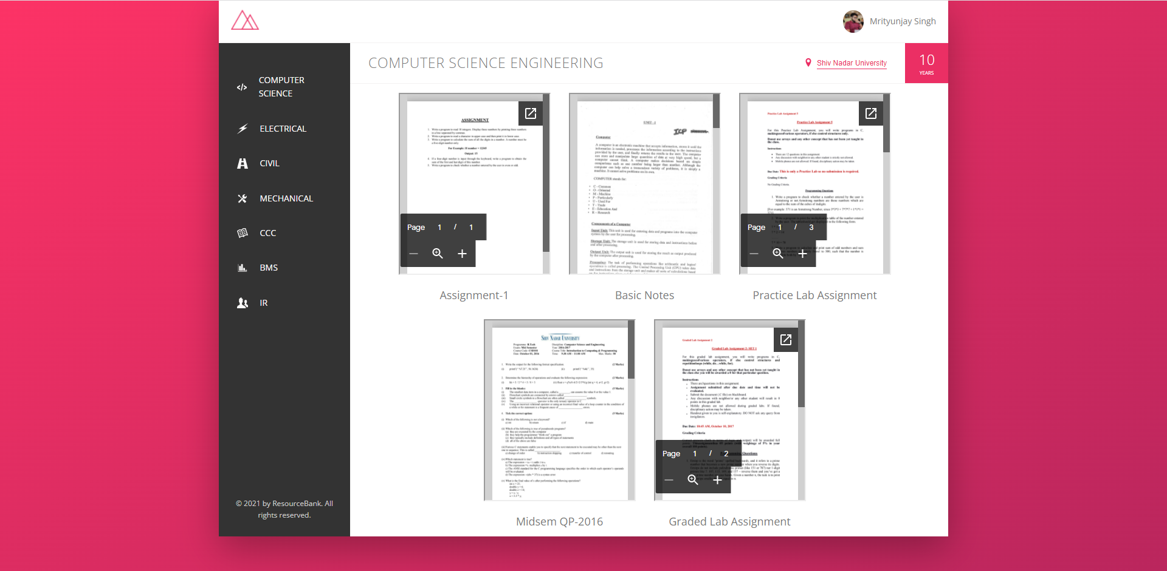
Resource Material

Slide 17

Thank You
“In order to succeed, your desire for success should be greater than your fear of failure.”
~ Bill Cosby

